Slide 1
Lesson Observation It’s harder than you think
Robert Coe, Durham University @ProfCoe
TeachFirst TDT meeting, 13 January 2014

Slide 2
Lesson Observation It’s harder than you think
Can observers judge the quality/effectiveness of teaching?
Are formative uses of observation better than ratings?
Does/Can observation improve teaching?
Ratings/judgements for accountability & QA
Formative observation for improvement

Slide 3
What kinds of evidence do we need?

Slide 4
researchED2013 Classroom observation: The new Brain Gym?
Validity evidence
Are observation ratings really a reflection of teaching quality?
Impact evaluation
Does the process of observation and feedback lead to improvement?
In what, how much and for what cost?

Slide 5
Can observers judge the quality/effectiveness of teaching?
Do observation ratings correspond with other indicators of teaching quality or effectiveness?
Student learning gains
Student ratings
Peer (teacher) perceptions
Self ratings
Are they consistent?
Across occasions
Across raters
Are ratings influenced by spurious confounds
Charisma, Confidence, Subject matter, Students’ behaviour, Time of day
Notes:
Strong, M., Gargani, J., & Hacifazlioglu, O. (2011). Do we know a successful teacher when we see one? Experiments in the identification of effective teachers. Journal of Teacher Education, 62(4), 367–382.
The authors report on three experiments designed to (a) test under increasingly more favorable conditions whether judges can correctly rate teachers of known ability to raise student achievement, (b) inquire about what criteria judges use when making their evaluations, and (c) determine which criteria are most predictive of a teacher’s effectiveness. All three experiments resulted in high agreement among judges but low ability to identify effective teachers. Certain items on the established measure that are related to instructional behavior did reliably predict teacher effectiveness. The authors conclude that (a) judges, no matter how experienced, are unable to identify successful teachers; (b) certain cognitive operations may be contributing to this outcome; (c) it is desirable and possible to develop a new measure that does produce accurate predictions of a teacher’s ability to raise student achievement test scores.
Heather C. Hill, Charalambos Y. Charalambous, and Matthew A. Kraft (2012) When Rater Reliability Is Not Enough: Teacher Observation Systems and a Case for the Generalizability Study. Educational Researcher, March 2012; vol. 41, 2: pp. 56-64.
Ho, A.D. and Kane, T. J. (2013). ‘The Reliability of Classroom Observations by School Personnel’. Research Paper. MET Project. Bill & Melinda Gates Foundation. Available at http://www.metproject.org/downloads/MET_Reliability%20of%20Classroom%20Observations_Research%20Paper.pdf

Slide 6
Does observation improve teaching?
Need studies with
Clearly defined intervention
High quality outcome measures (student learning)
Good control of counterfactual (eg RCT)
Adequate sample (ideally UK)
Measures of sustained impact
Independence of evaluator & developer
Key questions
Impact of formative obs on student outcomes
Costs of observing (inc opportunity costs)
Feasibility & optimum cost-benefit

Slide 7
‘Fundamental’ questions
What is good/effective teaching?
Define in terms of student outcomes (cf teacher behaviours, moral values/characteristics)
Outcomes need not just be standardised tests of maths and reading (but mostly are)
Can we keep it qualitative?
If qualitative judgements are evaluative, the same issues arise
If they are not evaluative, what is the point?
Notes:
Values: conscientious, puts interests of students first, reflective & self-critical, respectful, passion, charisma, kindness

Slide 8
Evidence of validity

Slide 9
Evidence from MET Project
Observation protocols:
CLASS http://metproject.org/resources/CLASS_10_29_10.pdf
FFT http://metproject.org/resources/Danielson%20FFT_10_29_10.pdf
MQI http://metproject.org/resources/MQI_10_29_10.pdf
PLATO http://metproject.org/resources/PLATO_10_29_10.pdf
Reliabilities for observation ratings from 0.24 – 0.68 (Mihaly et al, 2013, p22)
Correlations between observation and value-added from 0.17 – 0.42, median 0.30 (p24)
Correlations between observation and student ratings from 0.21 – 0.57, median 0.44 (p24)
Notes:
Mihaly, K., McCaffrey D. F., Staiger D. O., and Lockwood J. R. (2013) A Composite Estimator of Effective Teaching: Report for the Measures of Effective Teaching Project, Bill and Melinda Gates Foundation. Available at http://www.metproject.org/downloads/MET_Composite_Estimator_of_Effective_Teaching_Research_Paper.pdf

Slide 10
Do We Know a Successful Teacher When We See One?
Filmed lessons (or short clips) of effective (value-added) and ineffective teachers shown to
School Principals and Vice-Principals
Teachers
Public
Some agreement among raters, but unable to identify effective teaching
No difference between education experts and others
Training in CLASS did help a bit
Strong et al 2011
Notes:
Strong, M., Gargani, J., & Hacifazlioglu, O. (2011). Do we know a successful teacher when we see one? Experiments in the identification of effective teachers. Journal of Teacher Education, 62(4), 367–382. [Abstract at: http://jte.sagepub.com/content/62/4/367.abstract ]

Slide 11
Reliability
 |  | Probability that 2nd rater disagrees
1st rater gives | % | Best case r = 0.7 | Worst case r = 0.24
Outstanding | 12% | 51% | 78%
Good | 55% | 31% | 43%
Req. Impr. | 29% | 46% | 64%
Inadequate | 4% | 62% | 90%
Overall |  | 39% | 55%
Percentages based on simulations
Notes:
Reliability
Inter-rater reliability is the level of agreement between different observers who observe the exact same lesson (eg a video recording).
Best case estimate is from Sammons et al (2006): after 12 days training, inter-rater reliability was 0.7
Worst case is from Strong et al (2011, p372, Expt 1): untrained raters using their own criteria achieved inter-rater reliability of 0.24
Reliabilities of observation instruments used in the MET study (Mihaly et al, 2013, Table 2, p22) range from 0.24 to 0.68.

Slide 12
Validity
 |  | Probability value-added data disagrees
1st rater gives | % | Best case r = 0.4 | Worst case r = -0.3
Outstanding | 12% | 71% | 96%
Good | 55% | 40% | 45%
Req. improv. | 29% | 59% | 79%
Inadequate | 4% | 83% | >99%
Overall |  | 51% | 63%
Percentages based on simulations
Notes:
Validity
Validity indicates the level of agreement between an observation rating and other measures of teaching effectiveness, such as progress on assessments.
Best case is from the MET study (Mihaly et al, 2013, Table 3, p24). Correlations range from 0.17 to 0.42 between classroom observation measures and value-added.
Worst case is from Strong et al (2011, p372). They report that 40% of observer judgements classifying lessons into ‘good’ or ‘poor’ (with equal numbers in each, according to value-added) were correct. Since even pure guesses by chance would have got 50% correct, this indicates a negative relationship between lesson observation ratings and learning gains measured by value-added. An accuracy rate of 40% in this context corresponds with a point-biserial correlation of approximately -0.3.

Slide 13
How can something that feels so right be so wrong?

Slide 14
Obvious – but not true Why do we believe we can spot good teaching?
We absolutely know what we like
Strong emotional response to particular behaviours/styles is hard to over-rule
We focus on observable proxies for learning
Learning is invisible
Preferences for particular pedagogies are widely shared, but evidence/understanding of their effectiveness is limited
We assume that if you can do it you can spot it
We don’t believe observation can miss so much

Slide 15
Poor Proxies for Learning
Students are busy: lots of work is done (especially written work)
Students are engaged, interested, motivated
Students are getting attention: feedback, explanations
Classroom is ordered, calm, under control
Curriculum has been ‘covered’ (ie presented to students in some form)
(At least some) students have supplied correct answers (whether or not they really understood them or could reproduce them independently)
Notes:
Coe, R. (2013) Improving Education: A triumph of hope over experience. Inaugural Lecture of Professor Robert Coe, Durham University, 18 June 2013. Essay version available at http://www.cem.org/attachments/publications/ImprovingEducation2013.pdf Video at https://vimeo.com/70471076

Slide 16
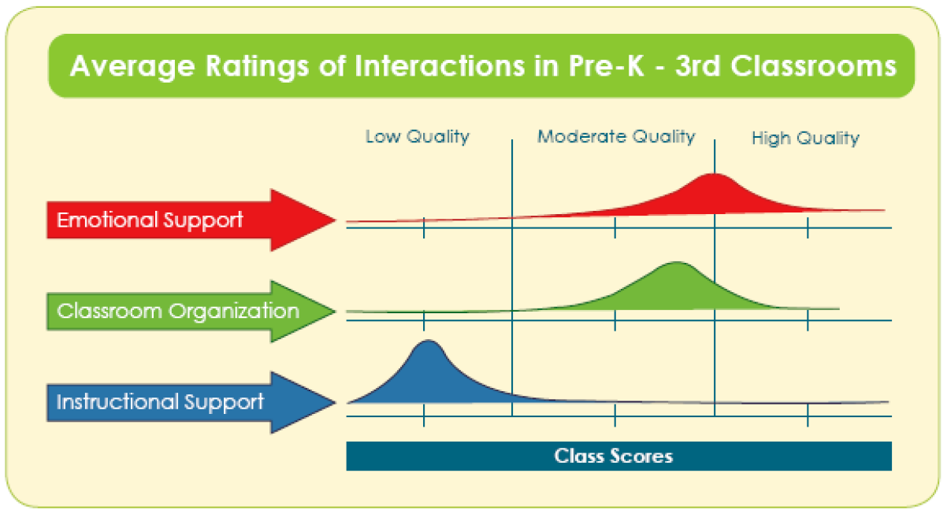
Hamre et al (2009)
Notes:
Hamre, B.K., Goffin, S.G. & Kraft-Sayre, M. (2009) Classroom Assessment Scoring System Implementation Guide: Measuring and Improving Classroom Interactions in Early Classroom Settings. http://www.teachstone.org/wp-content/uploads/2010/06/CLASSImplementationGuide.pdf
Instructional Support includes dimensions such as a the extent to which interactions promote higher order thinking, give formative feedback, and use language to promote thinking

Slide 17
Simons & Chabris (1999)
Notes:
Simons, D J, Chabris, C. F (1999) Gorillas in our midst: sustained inattentional blindness for dynamic events. Perception, 1999, volume 28, pages 1059 – 1074.

Slide 18
“We generally recommend that observers have some classroom experience. However, we sometimes find that individuals with the most classroom experience have the greatest difficulty becoming certified CLASS observers. Experienced teachers or administrators often have strong opinions about effective teaching practice. The CLASS requires putting those opinions aside, at least while using the CLASS, to attend to and score specific, observable teacher-child interactions.” (Hamre et al 2009, p35)
“Becoming a certified CLASS observer requires attending a two-day Observation Training provided by a certified CLASS trainer and passing a reliability test. The reliability test consists of watching and coding five 15-minute classroom video segments online … Trainings with a CLASS certified trainer result in 60-80% of trainees passing the first reliability test … CLASS Observation recertification requirements include annually taking and passing a reliability test.” (Hamre et al 2009, p37-8)
In the EPPE 3-11 study, observers had 12 days of training and achieved an inter-rater reliability of 0.7. (Sammons et al 2006, p56)
Notes:
Hamre, B.K., Goffin, S.G. & Kraft-Sayre, M. (2009) Classroom Assessment Scoring System Implementation Guide: Measuring and Improving Classroom Interactions in Early Classroom Settings. http://www.teachstone.org/wp-content/uploads/2010/06/CLASSImplementationGuide.pdf
Sammons, P., Taggart, B., Sylva, K., Melhuish, E., Siraj-Blatchford, I., Barreau, S. and Manni, L. (2006) Variations in teacher and pupil behaviour in Year 5 classes. Effective Pre-School and Primary Education 3-11 Project (EPPE 3-11). London: Institute of Education http://eppe.ioe.ac.uk/eppe3-11/eppe3-11%20pdfs/eppepapers/Tier%203%20full%20report%20-%20Final.pdf

Slide 19
Impact of observation

Slide 20
Formative observation
Validity issues still apply
Advice about how to ‘improve’ could make it worse (but practice is so hard to change this is unlikely)
Wider evidence on feedback suggests large positive effects are possible
But also evidence on accountability and evaluation suggests summative observation can be positive
In all cases, benefits must outweigh costs

Slide 21
Existing evidence
Evidence on Feedback
Kluger & DeNisi (1996); Coe. (2002); Hattie & Timperley (2007)
Accountability/league tables
Burgess et al (2010); Hanushek & Raymond (2005); Dee & Jacob (2009)
Impact of classroom observation
Allen et al (2011): mixed & odd findings (ctrl gp declined) ES=0.22, based on 20 hrs CPD over 13 months, cost $3700 per teacher (with Grade 8 students)
Taylor & Tyler (2012): Positive effect (0.11) for cost of $7,500 per observee
Bristol/EEF study: reports in 2017
Notes:
Evidence on Feedback:
Kluger, A.N. & DeNisi, A. (1996) The effects of feedback interventions on performance: a historical review, a meta-analysis, and a preliminary feedback intervention theory, Psychological Bulletin, 119, pp. 254-284.
Coe, R. (2002) ‘Evidence on the Role and Impact of Performance Feedback in Schools’ in A.J.Visscher and R. Coe (eds.) School Improvement Through Performance Feedback. Rotterdam: Swets and Zeitlinger (23pp).
Hattie, J. & Timperley, H. (2007) ‘The Power of Feedback’, Review of Educational Research, 77, 1, pp. 81-112.
League tables:
Burgess, S., Wilson, D., & Worth, J. (2010). A natural experiment in school accountability: the impact of school performance information on pupil progress and sorting. Centre for Market and Public Organisation. http://www.bris.ac.uk/education/events/2011/burgesspaper.pdf
Hanushek, E. and Raymond M.. 2005. “Does School Accountability Lead to
Improved Student Performance?” Journal of Policy Analysis and Management, 24(2) p297-
327.
Dee T & Jacob B (2009) The Impact of No Child Left Behind on Student Achievement. NBER Working Paper No. 15531 November 2009. http://www.nber.org/papers/w15531
Impact of classroom observation:
Allen, J. P., Pianta, R. C., Gregory, A., Mikami, A. Y., & Lun, J. (2011). An interaction-based approach to enhancing secondary school instruction and student achievement. Science, 333, 1034–1037.
Taylor, E. S., & Tyler, J. H. (2012). The effect of evaluation on teacher performance. The American Economic Review, 102(7), 3628-3651.
Bristol University / EEF study underway: http://educationendowmentfoundation.org.uk/projects/teacher-peer-observation-bristol-university

Slide 22
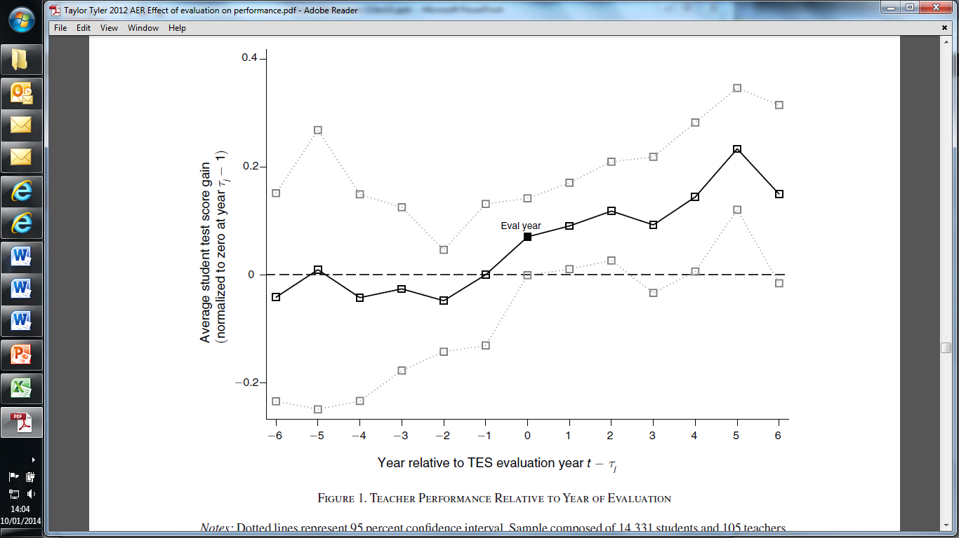
Taylor & Tyler, 2012, AER
Notes:
Taylor, E. S., & Tyler, J. H. (2012). The effect of evaluation on teacher performance. The American Economic Review, 102(7), 3628-3651.
Cincinnati Teacher Evaluation System, using Danielson’s FFT, between 2003-2010. Observation/evaluation produces 0.11 ES gain in math test scores every year thereafter. http://educationnext.org/can-teacher-evaluation-improve-teaching/

Slide 23
Recommendations

Slide 24
What should we do?
Stop assuming that untrained observers can either make valid judgements or provide feedback that improves anything.
Apply a critical research standard and the best existing knowledge to the process of developing, implementing and validating observation protocols.
Ensure that good evidence supports any uses or interpretations we make for observations.
appropriate caveats around the limits of such uses should be clearly stated and the use should not go beyond what is justified.
Undertake robustly evaluated research to investigate how feedback from lesson observation might be used to improve teaching quality

