Slide 1
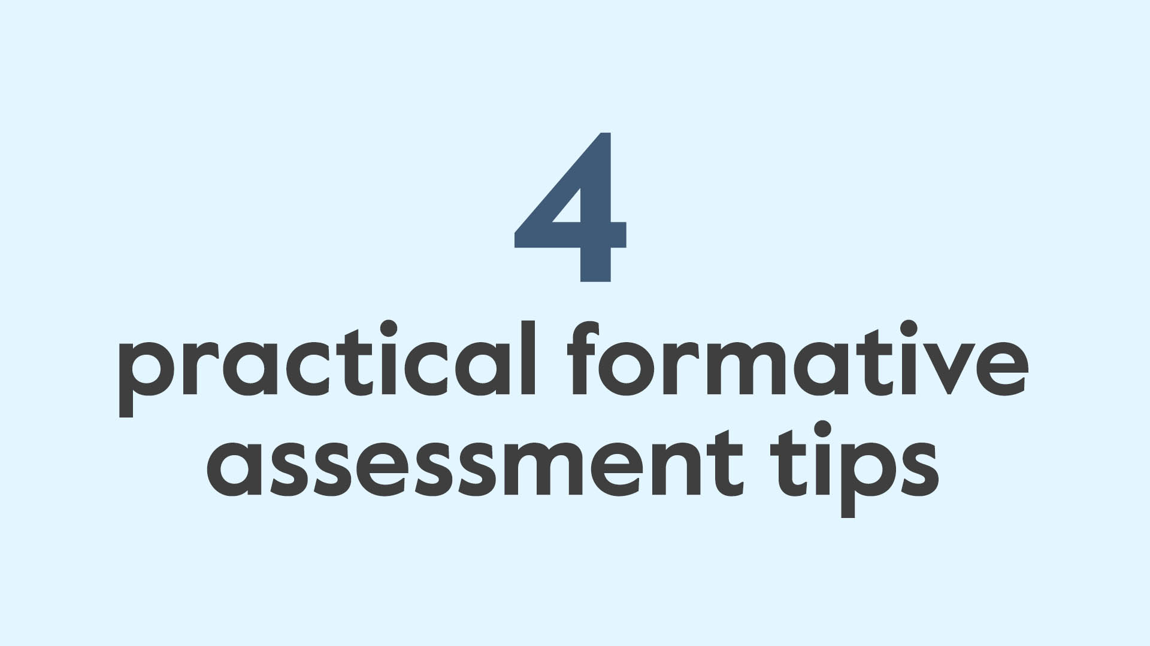
4 practical formative assessment tips

Slide 2
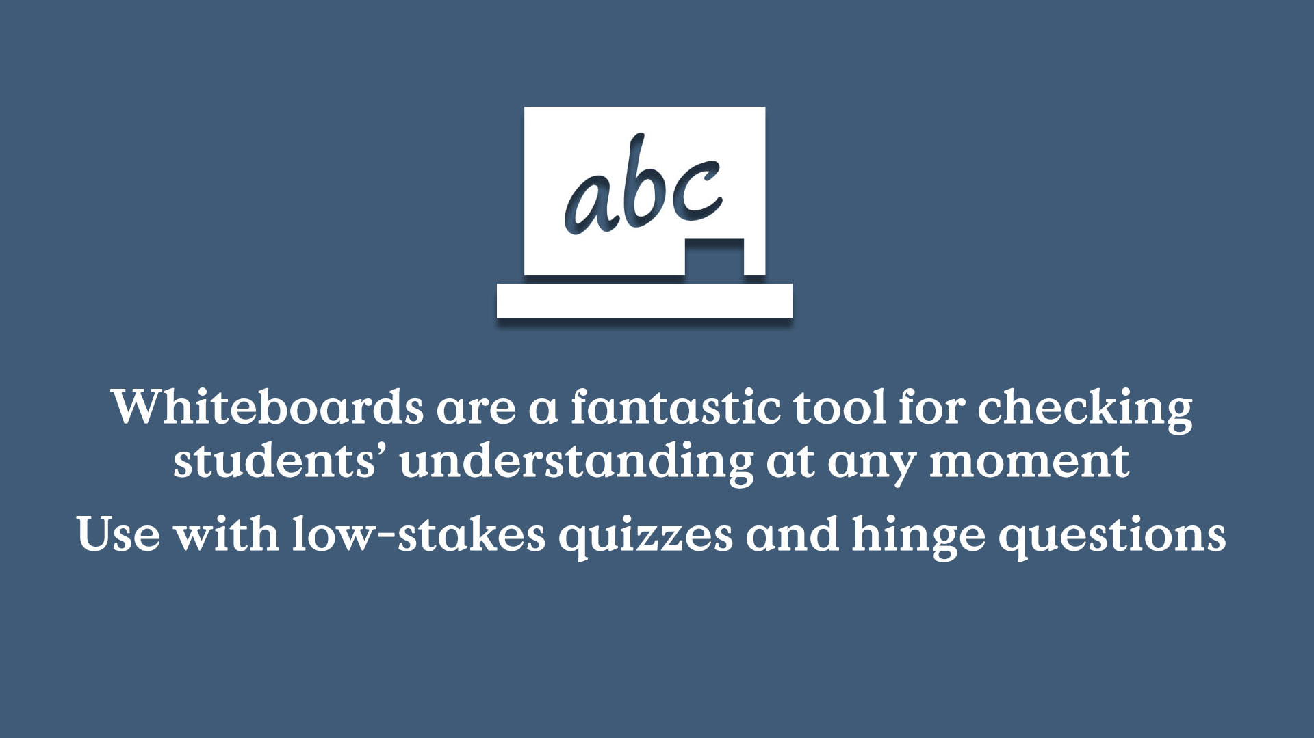
Mini whiteboard icon
A fantastic tool for checking students’ understanding at any moment
Use with low-stakes quizzes and hinge questions

Slide 3

Pen & pencil icon
Ask students to write down absolutely everything they know about a topic
Use at the beginning of the topic and the start of lessons to check recall

Slide 4

Poll icon
Go high-tech with polls to ask multiple-choice questions with apps like Plikers
Use in class or for homework to help you see where you need to go next

Slide 5
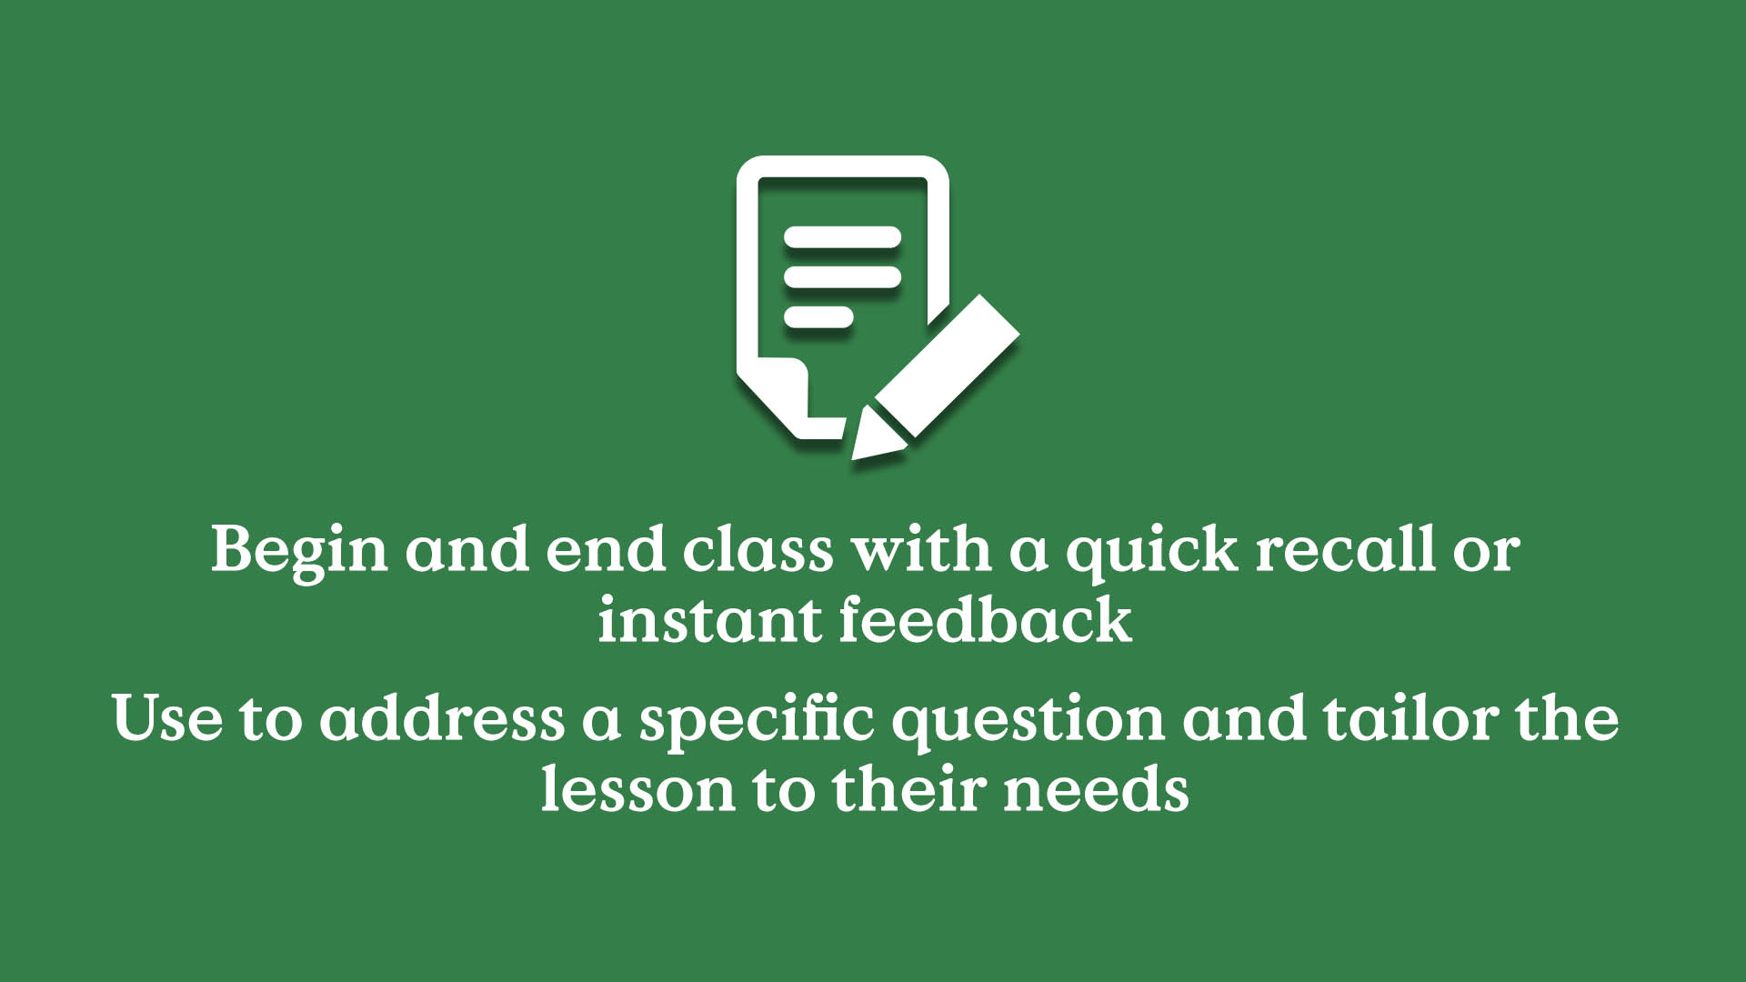
Post it note icons
Begin and end class with a quick recall or instant feedback
Use to address a specific question and tailor the lesson to their needs

