Slide 1

How can teachers learn to be better teachers?
@ProfCoe
Robert Coe, Durham University
Telegraph Festival of Education, Wellington College, June 2017

Slide 2
How can teachers learn to be better teachers?
You’re a teacher.
You know how to help
people learn hard stuff.
Do that.

Slide 3


Notes:
https://www.gov.uk/government/publications/standard-for-teachers-professional-development
Cordingley, P., Higgins, S., Greany, T., Buckler, N., Coles-Jordan, D., Crisp, B., Saunders, L., Coe, R. (2015) Developing Great Teaching: Lessons from the international reviews into effective professional development. Teacher Development Trust. http://tdtrust.org/about/dgt/
The CPD Test: http://tdtrust.org/cpdtest/

Slide 4
What do we know about teachers’ professional learning?
Three types of requirement
  General principles of how people learn anything
  Specific requirements for learning to change pedagogical practice
  The learning environment: school culture and leadership

Slide 5
All good learning & teaching …
Takes you from where you are at
Is clear what success looks like
Creates challenging expectations
Assesses and feeds back on the gap
Requires exposition and guidance from an expert
Requires a coaching & mentoring role
Benefits from peer support
Requires trust: ‘OK to fail’

Slide 6
Principles for learning to change pedagogical practice
Learning aims (for teachers) must be strongly linked to learning gains (for pupils)
Learning aims must be evidence based
Learning aims must be appropriate to school/pupil context
Changing habits that are already established is very hard (needs time, support, feedback)
Pedagogy is a blend of theory (wisdom and intuition) and practice (skills and techniques)

Slide 7
Leadership, school culture and professional learning
The value of professional learning and continuous improvement must be clearly signalled (championed and modelled)
Time and funding must be made available
A trust culture (‘willingness to be vulnerable’ = please observe my worst lesson) is vital
Challenge implies need for improvement
Requires coherence with a wider strategic planning process for prioritisation and integration
Notes:
Tschannen-Moran, M., & Hoy, W. K. (2000). A multidisciplinary analysis of the nature,
meaning, and measurement of trust. Review of Educational Research, 70(4), 547-593.

Slide 8

Some pitfalls of professional learning
Link (teacher) learning aims to (student) learning gains
Change habits, not just knowledge
Use assessment
(for professional learning)
Don’t forget instruction
Culture is crucial
Practice makes less imperfect

Slide 9
Some pitfalls of professional learning:
1. Link (teacher) learning aims to (student) learning gains

Slide 10

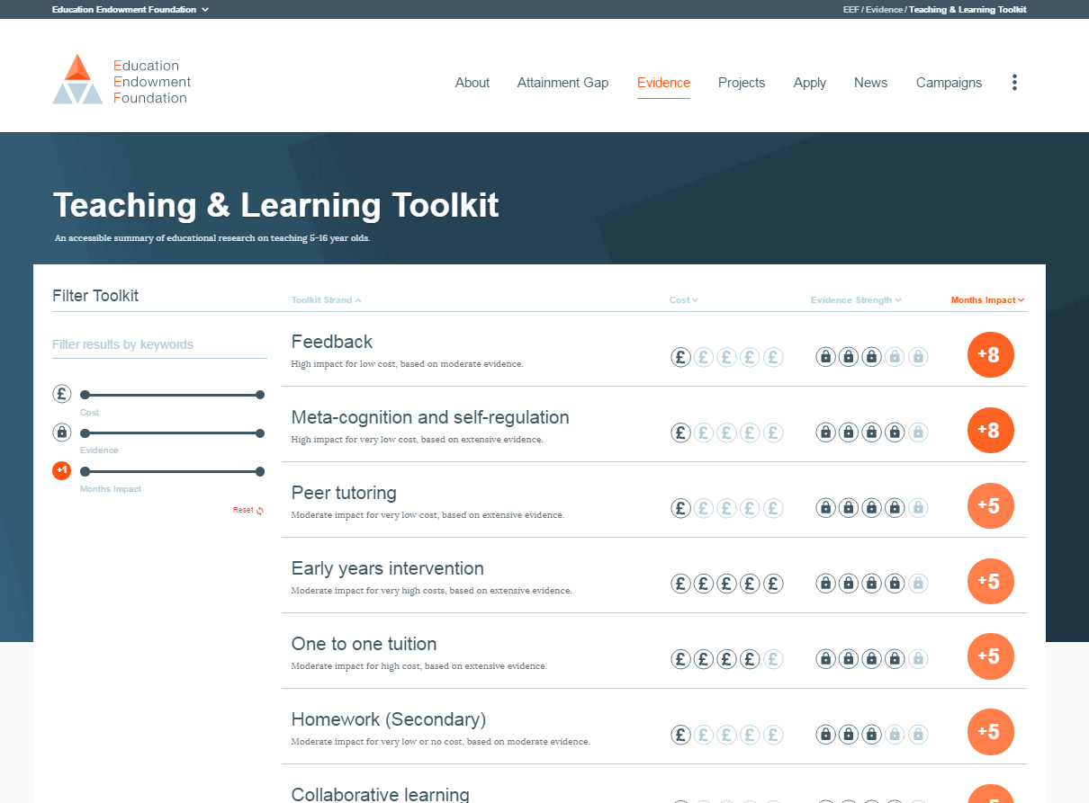
EEF Teaching and Learning Toolkit www.educationendowmentfoundation.org.uk/toolkit
Notes:
Higgins, S., Katsipataki, M., Kokotsaki, D., Coleman, R., Major, L.E., & Coe, R. (2013). The Sutton Trust-Education Endowment Foundation Teaching and Learning Toolkit. London: Education Endowment Foundation. [Available at http://www.educationendowmentfoundation.org.uk/toolkit]
Hattie, J. (2009) Visible Learning: A synthesis of over 800 meta-analyses relating to achievement. Abingdon: Routledge.

Slide 11
Impact vs cost
www.educationendowmentfoundation.org.uk/toolkit
Most promising for raising attainment
8
Feedback
May be worth it
Meta-cognitive
Mastery
Homework (Secondary)
Peer tutoring
1-1 tuition
Early Years
Effect Size (months gain)
Reading comprn
Collaborative
Behaviour
Phonics
Small gp tuition
Parental involvement
Smaller classes
Social
ICT
Individualised learning
Summer schools
After school
Small effects / high cost
Homework (Primary)
Mentoring
Teaching assistants
0
Performance pay
Aspirations
£0
Ability grouping
£1000
Cost per pupil
Repeating a year

Slide 12


Slide 13

1. We do that already (don’t we?)
Reviewing previous learning
Setting high expectations
Using higher-order questions
Giving feedback to learners
Having deep subject knowledge
Understanding student misconceptions
Managing time and resources
Building relationships of trust and challenge
Dealing with disruption

Slide 14

2. Do we always do that?
Challenging students to identify the reason why an activity is taking place in the lesson
Asking a large number of questions and checking the responses of all students
Raising different types of questions (i.e., process and product) at appropriate difficulty level
Giving time for students to respond to questions
Spacing-out study or practice on a given topic, with gaps in between for forgetting
Making students take tests or generate answers, even before they have been taught the material
Engaging students in weekly and monthly review

Slide 15

3. We don’t do that (hopefully)
Use praise lavishly
Allow learners to discover
key ideas for themselves
Group learners by ability
Encourage re-reading and highlighting to memorise key ideas
Address issues of confidence and low aspirations before you try to teach content
Present information to learners in their preferred learning style
Ensure learners are always active, rather than listening passively, if you want them to remember

Slide 16
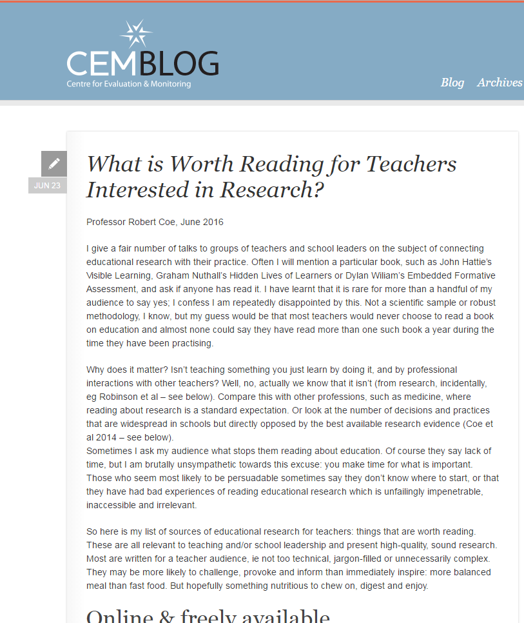

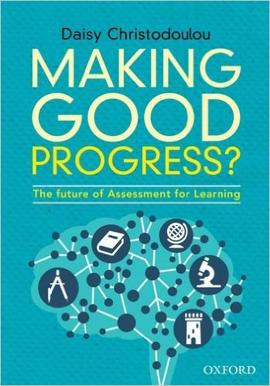
Professional reading http://cem.org/blog/what-is-worth-reading-for-teachers-interested-in-research
Reports (online & free)
  Effective pedagogy (6)
  Impact of interventions (3)
  How learning happens (8)
  Teachers’ PD (2)
  School improvement and leadership (3)
Books (8)
Blogs (10)
And two new books:

Slide 17
Further reading lists
Tom Sherrington (@Teacherhead)
  https://teacherhead.com/2017/06/03/teaching-and-learning-research-summaries-a-collection-for-easy-access/
Harry Fletcher-Wood (@HFletcherWood)
  https://improvingteaching.co.uk/2017/06/04/a-reading-list-learning-teaching-professional-development/
Nick Rose (@Nick_J_Rose)
  https://www.tes.com/news/tes-magazine/tes-magazine/are-these-7-pillars-classroom-practice?amp
Paul Kirschner (@P_A_Kirschner)
  https://3starlearningexperiences.wordpress.com/2017/02/28/seminal-papers-in-educational-psychology/

Slide 18

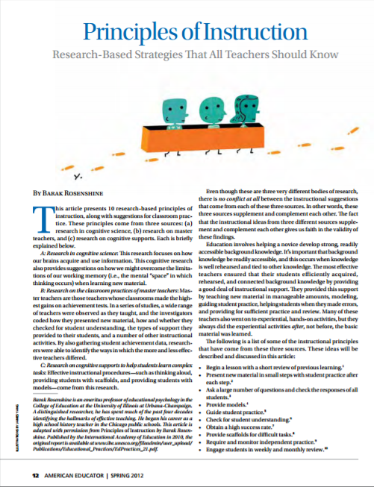
Starter pack: 50 pages
Notes:
Coe, R., Aloisi, C., Higgins, S. and Elliot Major, L. (2014) ‘What makes great teaching? Review of the underpinning research’. Sutton Trust, October 2014 http://www.suttontrust.com/researcharchive/great-teaching/
Rosenshine, B. (2012) Principles of Instruction: Research based principles that all teachers should know. American Educator, Spring 2012. http://www.aft.org/pdfs/americaneducator/spring2012/Rosenshine.pdf
Deans for Impact (2015). The Science of Learning. Austin, TX: Deans for Impact. http://deansforimpact.org/pdfs/The_Science_of_Learning.pdf
Cordingley, P., Higgins, S., Greany, T., Buckler, N., Coles-Jordan, D., Crisp, B., Saunders, L., Coe, R. (2015) Developing Great Teaching: Lessons from the international reviews into effective professional development. Teacher Development Trust. http://tdtrust.org/about/dgt/

Slide 19
Some pitfalls of professional learning:
2. Change habits, not just knowledge

Slide 20
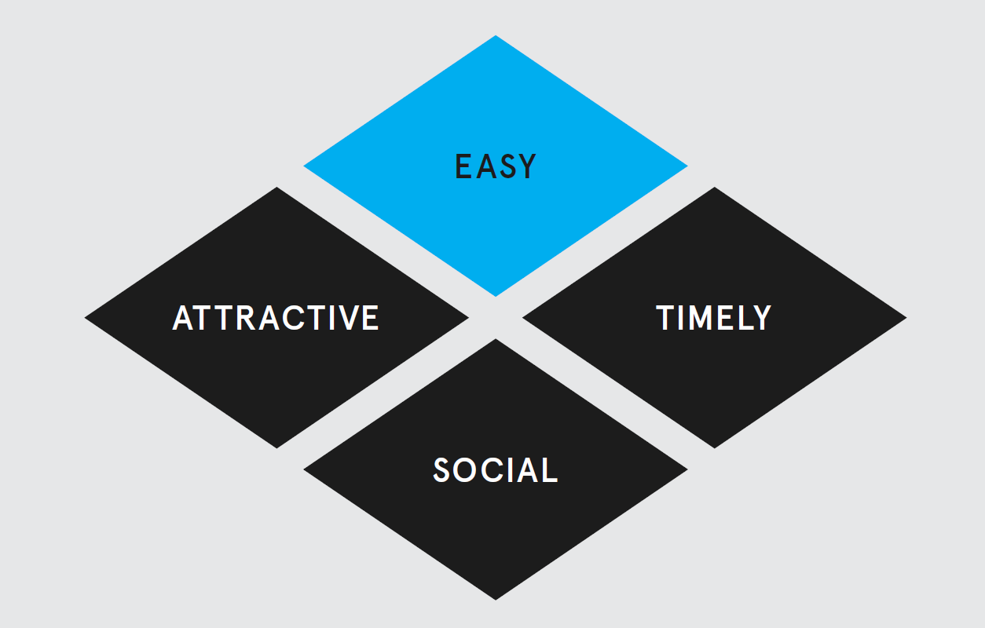
“Teacher professional developers have more to learn from
Weight Watchers than from traditional educational
psychology.”
Dylan Wiliam
Notes:
Wiliam, D. (2008) Assessment for Learning: why, what and how
http://dylanwiliam.org/Dylan_Wiliams_website/Papers_files/Cambridge%20AfL%20keynote.doc
Behavioural Insights Team (2014) EAST: Four Simple Ways to Apply Behavioural Insights.
http://www.behaviouralinsights.co.uk/publications/east-four-simple-ways-to-apply-behavioural-insights/
See also https://www.instituteforgovernment.org.uk/sites/default/files/publications/MINDSPACE.pdf

Slide 21
Some pitfalls of professional learning:
3. Use assessment (for professional learning)

Slide 22
How good a teacher are you?
Well above average
Above average
Average
Below average
Well below average
How do you know?

Slide 23
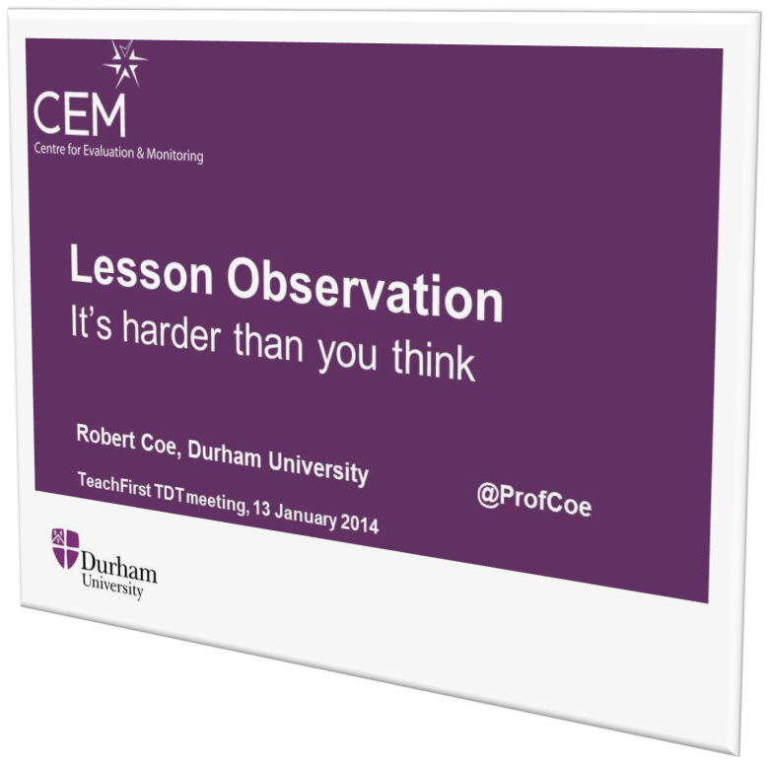
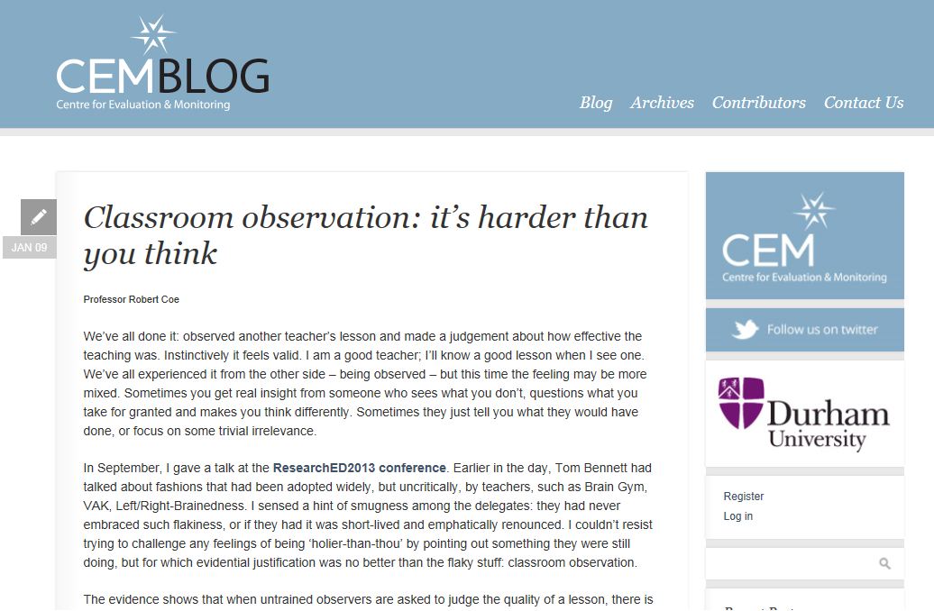
Lesson observation:
It’s harder than you think
Notes:
http://www.cem.org/blog/414/

Slide 24
How do you know if teaching is working?
High-quality assessment
  Not levels (generalised descriptors/criteria)
  Convergent with learning goals & other evidence
  Check for bias & confounds
Lesson observation
  Be very cautious! (no grades or consequences)
  Based on ‘Great Teaching’ evidence
  Trust teachers with consistently good outcomes
Student feedback
  Use validated instruments

Slide 25

Using good assessment to monitor teaching
Standardised
  criteria, exemplars, context, moderation, objective
Reliable
  accurate, consistent across teachers
Aligned
  Captures valued learning
Notes:
cem.org

Slide 26
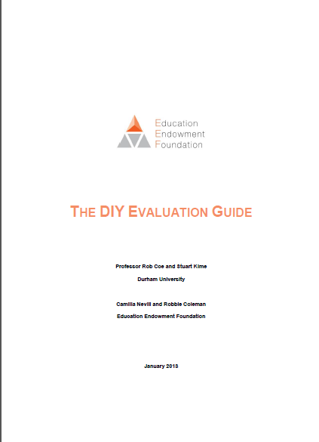
Key elements of good evaluation
EEF DIY Evaluation Guide
Clear, well defined, replicable intervention
Good assessment of appropriate outcomes
Well-matched comparison group
Notes:
Coe, R., Kime, S., Nevill, C. and Coleman, R. (2013) ‘The DIY Evaluation Guide’. London: Education Endowment Foundation. [Available at:
http://educationendowmentfoundation.org.uk/library/diy-evaluation-guide
https://v1.educationendowmentfoundation.org.uk/uploads/pdf/EEF_DIY_Evaluation_Guide_(2013).pdf
http://educationendowmentfoundation.org.uk/uploads/pdf/EEF_DIY_Evaluation_Guide_(2013).pdf
https://educationendowmentfoundation.org.uk/resources/diy-guide/getting-started/

Slide 27
Some pitfalls of professional learning:
4. Don’t forget instruction

Slide 28
If you want your students to learn something hard, would you
Get them into groups to work it out for themselves
Provide explicit instruction in the ideas/techniques and actively manage their learning (as an expert in both the subject matter and in pedagogy)

Slide 29
All good learning & teaching …
Takes you from where you are at
Is clear what success looks like
Creates challenging expectations
Assesses and feeds back on the gap
Requires exposition and guidance from an expert
Requires a coaching & mentoring role
Benefits from peer support
Requires trust: ‘OK to fail’

Slide 30
Some pitfalls of professional learning:
5. Culture is crucial

Slide 31
What is trust?
Inter-dependence, risk of harm
“willingness to be vulnerable to another party based on the confidence that the latter party is
(a) benevolent,
(b) reliable,
(c) competent,
(d) honest, and
(e) open”
(Tschannen-Moran & Hoy, 2000)
Good intentions, would not exploit
Lack of anxiety
Predictability, consistency of behaviour
Skills, abilities, power
Willing to share (personal) information
character, integrity, authenticity
Notes:
Tschannen-Moran, M., & Hoy, W. K. (2000). A multidisciplinary analysis of the nature,
meaning, and measurement of trust. Review of Educational Research, 70(4), 547-593.

Slide 32
Trust in school
Schools “with weak trust reports … had virtually no chance of showing improvement” (Bryk & Schneider, 2002, p. 111).
‘Academic Optimism’ (Hoy et al, 2006)
  Academic Emphasis: press for high academic achievement
  Collective Efficacy: teachers’ belief in capacity to have positive effects on students
  Trust: teachers’ trust in parents and students
If what you are doing isn’t good, do you want to
  Cover it up, ignore, hide, minimise its importance
  Expose it, share, examine, maximise the learning opportunity
Notes:
Bryk, A., & Schneider, B. (2002). Trust in schools. New York: Russell Sage.
Hoy, W. K., Tarter, C. J., & Hoy, A. W. (2006). Academic optimism of schools: A force for student achievement. American educational research journal, 43(3), 425-446.

Slide 33
Some pitfalls of professional learning:
6. Practice makes less imperfect

Slide 34


Deliberate practice
Challenge
Specific goals
Focus on sub-tasks
Feedback
Mental representations
Notes:
Ericsson, K. A. & Pool, R. (2016). Peak: Secrets from the New Science of Expertise. Boston, MA: Houghton Mifflin Harcourt
Deans for Impact (2016). Practice with Purpose: The Emerging Science of Teacher Expertise. Austin, TX: Deans for Impact.
https://deansforimpact.org/resources/practice-with-purpose/

Slide 35
How can teachers learn to be better teachers?
@ProfCoe

Slide 36
How can teachers learn to be better teachers?
You’re a teacher.
You know how to help
people learn hard stuff.
Do that.

