Slide 1
Retirement from CEM
Peter Tymms (1987-2016)
Research Associate 87-90
Newcastle 92-95
Director of CEM 03-10

Slide 2
Who is here?
Educationalists
  CEM – now and earlier
  School of Education – now and earlier
  Newcastle University – now and earlier
  Educational Organisations
  PhD students past and present
Friends and relations
Including
  Physicists
  Statisticians
  Phychologists
  Medics and health related folk
  A Vet
  A Tax man
  A stand up comic

Slide 3
Outline
Excerpts from my time in CEM
  Development
  Using the data systematically
  Interventions
  Challenging policy and practice
  Opportunistic research
  What now?

Slide 4
A Scatterplot

Slide 6
Background to CEM
To improve education by using the methods of science
This implies a need for
  Ongoing monitoring
  Interventions
The Monitoring Model: ALIS
  Confidential
  Measurement-based
  Self-evaluation

Slide 7
CEM Growth
Kate Bailey
Christine Merrell
Paul Jones
Rod Bramald
Pat Preedy
Stephen Albone
Mark Wightman

Slide 8
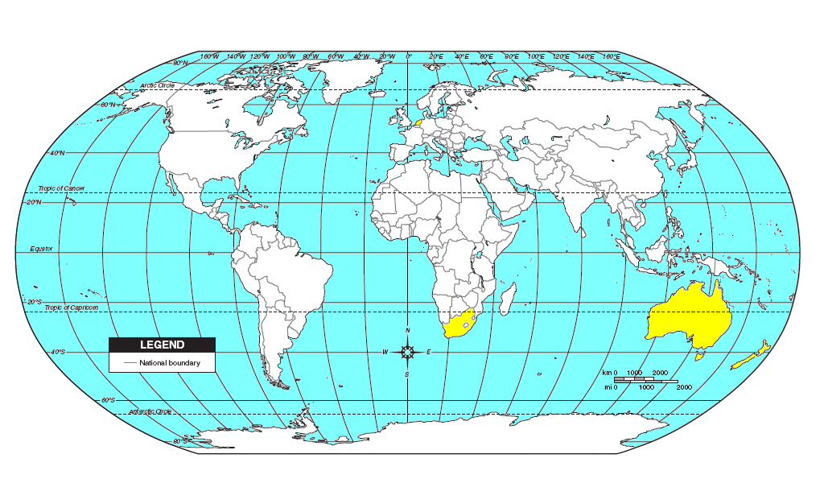
Non-UK Schools Participating in CEM Centre Projects 2007/08
Netherlands
6/3
0/32
1/0
2/1
Belgium
3/0
12/2
0/1
6/0
2/0
0/1
4/2
4/0
14/2
2/1
1/1
Qatar
6/2
6/2
5/1
3/2
UAE
11/3
3/1
Bermuda
1/0
Cyprus
5/0
Oman
3/0
0/1
11/4
Bahrain
3/1
1/2
Hong Kong
5/30
0/1
0/1
6/2
Brunei
0/1
Cayman Is.
2/0
1/0
3/1
Singapore
5/4
1/12
21/22
0/775
193/72
Falklands
2/0
Right of slash: contracts with primary schools
Mauve box: standard CEM Centre projects run in non-UK schools
Yellow box: local versions of CEM Centre projects
Left of slash:
contracts with secondary schools
2/1
0/32

Slide 9
Development
System creation
  PIPS
  INCAS
    Identifying reading problems
  P scales
  iPIPS
Test development
  BLA 93
  Year 1 to 8
Advice (Designing monitoring systems)
  VANP 96-97
  Technical and Ethical Issues in Indicator Systems 2002
  China 05--07
  NICE
  Northern Ireland 2016
Technical
  Effect Sizes in MLMs
  Rasch Users’ group
  SD changes as a result of interventions
Gaynor Richardson Michelle Dixon Sarah Craggs
David Moseley
David Hawker
SM Tsui Rob Coe Emma Beatty
Kapil Sayal
David Galloway
Adetayo Kasim

Slide 10
Baseline for PIPS
The challenges
  Children do not read nor write
  Limited STM
  Limited time for the assessment
  Limited time to train assessors
  Enormous rage of ages and developmental levels
  Special needs and 1st language

Slide 11
Constraints and solutions
Must be enjoyable
Must be one-to-one
Many short different parts
Use sequences with stopping rules
Recorded sound
Special arrangements for special needs
Separate teacher rating for PSD & behaviour

Slide 12
Demo of the Dutch version
Story

Slide 13
Use of the PIPS Baseline
Assessed > 2 million children since 1994
Translated/adapted into 12 languages
Used for formative feedback over 20 years
Assesses at the start and end of first year at school
Early reading and early maths
PSD, behaviour, physical development

Slide 14
Using data systematically
Tracking students through their schooling
  First Years at School;
  First Three Years
  First Seven years
  BLA to GCSE
Inattention, hyperactivity and impulsiveness;
  Prevalence of sub-clinical feature
  Links to attainment
International comparisons

Slide 15
Baseline to GCSE: Questions
How well does PIPS predict GCSE?
Does an “effective” class impact on later success?

Slide 16
The data
45,000 cases
Assessments
  Start of Reception (age 4)
  End of reception (age 5)
  End of KS1 (age 7)
  End of KS2 (age 11)
  GCSE (maths and English at age 16)
Background data
  Lots

Slide 17
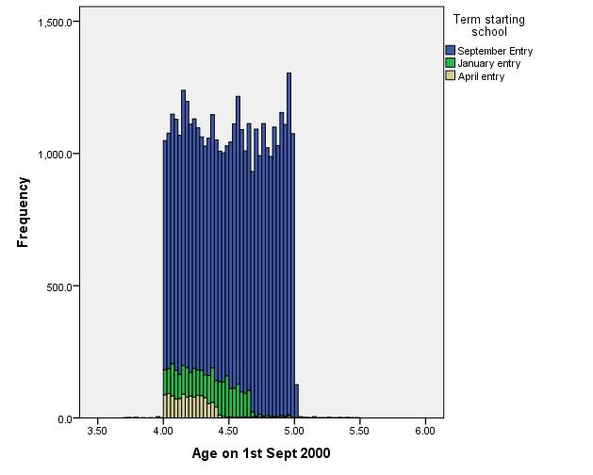
Age and term of starting school

Slide 18
Prediction of GCSE
Correlations: with start of Reception scores

Slide 19
The first year at school
Massive gains
  Reading: Effect Size=2.8
  Maths: Effect Size=2.2
  Copy of Normal curve and ES2.xls
Big difference between classes

Slide 20
Does an “effective” class impact on later success?

Slide 21
Interventions
Feedback to schools ‘96
Advice to teachers ‘02
Peer Tutoring ‘06-’07
Physical activity levels ‘14-’15
David Bolden

Slide 22
Challenging policy and practice
Testing
  Opening a can of worms
Accountability
  Can it be Fair?
  Dysfunctional Effects of League Tables
  Ofsted
  Standards over time: KS2, BLA, GCSE, A level
Effectiveness studies
  School effectiveness at an impasse
  Effects of Student Composition on School Outcomes
Andy Wiggins
Karen Jones
Rob Coe

Slide 23
Standards at the end of KS2
Massive efforts to raise standards in England
National Curriculum - 1988
National testing – 1991-95
Ofsted - 1992
More than 600 initiatives for Basic Skills in primary schools
National Numeracy Strategy
National Literacy Strategy
League tables, target setting, homework clubs, etc etc etc

Slide 24
Costs
Ofsted
  £100, 000,000 a year
NNS
  £500,000,000
NLS
  £500,000,000
National testing
  £40 per pupil per subject per year

Slide 25
KS2 Percent With Level 4+

Slide 26
Independent data Reading and maths in primary schools
PIPS Y6
Massey et al
Davis & Brember
PIPS Y4
MidYIS Y7
QCA/DFES/NFER Y5
Brown et al
LEA 1
LEA 2
LEA 3
LEA 5
LEA 6
Surrey Y7

Slide 27
That is, from:
Twelve independent studies
Two thirds of a million assessments

Slide 28
What really happened

Slide 29
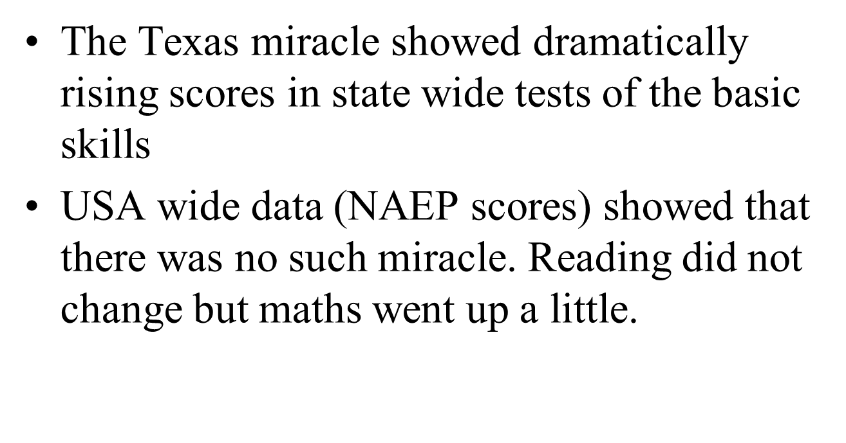
We are no alone

Slide 30
Why did basic skills not improve?
Policies without an evidence base
Assumption that common sense is enough
Inherent resistance
The way ideas in education spread
The fallacy of transplanting good practice
Unintended consequences
The levels were already high and teachers were doing a good job

Slide 31
Opportunistic research
Birthweight, weight gain in infancy
Do men bring out the best in boys and women the best in girls
Homework
Bruce Carrington

Slide 32
What now?
iPIPS
Sex differences
Number scale
Regression discontinuity and STM
Standards over time – international
Helen Gray; Andrew Lyth; Catherine McKenna; Susan Stothard; Lee Copping
Lee Copping, John Little, Helen Cramman
Jens and Nadin Beckmann
Cesare Aloisi

Slide 33
The Western Cape: Grade 1

Slide 34
The iPIPS project
International project to monitor children’s development on entry to school and progress to end of first year
Used in:
  England
  Scotland
  Australia
  Netherlands
  New Zealand
  Russia
  Brazil
  South Africa
  Abu Dhabi
  China
  Slovenia
  Germany
  Serbia

Slide 35
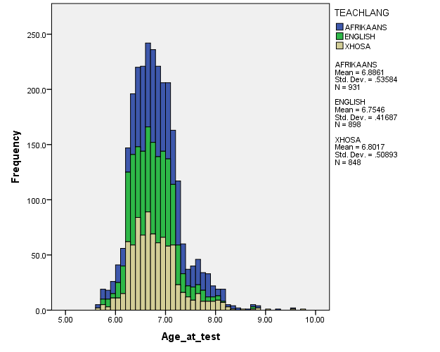
Ages at the start of year

Slide 36

Massive variation in backgrounds
From a questionnaire to parents
  Lowest 20% no tap water and no electricity
  Highest 20% internet connect, TV and flushing toilet

Slide 37
Making comparisons
We are able to compare reading and maths across the three languages

Slide 38
Progress in Reading
Start %
End %
Comprehension
1.8
16.7
Sentences
5.9
40.3
Words
39.0
79.7
Letters
96.5
99.8
Ground
100
100

Slide 39
Reading: Links to end of year

Slide 40
Behaviour
England

Slide 41
That scattergram again

Slide 42
Thank you

