Slide 1

Reporting the evidence:
what research can tells us about how assessment data is used
Katharine Bailey

Slide 2
Introduction
Audience participation
Links between assessment data and pupil outcomes
A new study

Slide 3


Impact of assessment data

Slide 4
Impact of data use on pupil outcomes
Little evidence of direct impact on pupil outcomes
  Complexity of factors involved
  Causality
Mediating factors
Need for well designed studies that explore impact
  RCT

Slide 5



Mediating factors

Slide 6
Reports
Must be well designed and use best available evidence
Should be validated
Uses should be made clear
Desirable difficulty
This isn’t the norm …

Slide 7
School culture and leadership
Data rich or data poor schools
Approach to data use
Data use led from the top
Approach to accountability

Slide 8
Engagement and ownership
Who owns the data?
How often is it used?
Who has access to what parts?
Is time made available?

Slide 9
Understanding
Data literacy
  Knowledge
    Literacy skills
    Statistical knowledge
    Mathematical knowledge
    Context knowledge
    Critical questions
  Dispositions
    Beliefs and attitudes
    Critical stance
Assessment literacy

Slide 10
Some promising evidence
Carlson, Borman et al 2011
  District level RCT with 59 schools
  Extensive training on use of assessment and other forms of data
  Improvement in maths, less so in reading, small effects

Slide 11
Li, Fortner et al. 2015
Looked at data from PISA school questionnaire on use of test results
  Monitoring progress
  Judging teacher/school effectiveness
  Decisions about grade promotion
  Identifying areas for improvement
Positively related to pupil outcomes only when data was used to hold school to account
No relationship when data used for instructional purposes

Slide 12
New evidence
Introduction of a reception baseline assessment in 2015 as part of primary accountability reform
Requirement for schools to assess children’s developmental level in early literacy and early maths on entry to school at the age of 4/5
Replaced a system of continuous teacher observation across the whole of the first year in school

Slide 13
BASE assessment
Based on widely used PIPS Baseline Assessment with a 20 year history
Grounded in educational research
Computer-adaptive assessment carried out during the child’s first half term in Reception
15-20 minute assessment time
Literacy, Maths, Personal, Social & Emotional Development
Optional follow-up assessment at end of Reception year will show the progress made by each child
The starting point for tracking progress through Primary school

Slide 14
BASE reporting
Combination of static pdfs and interactive dashboards using Tableau
Tiered reporting options
  BASEline
  BASE progress
  BASE inspection ready
Amount of data and interactivity increases with package

Slide 15
BASEline
Start of reception
Increased interactivity & content of report
BASE Progress
Start of reception
End of reception
BASE Inspection
Start of reception
End of reception

Slide 16
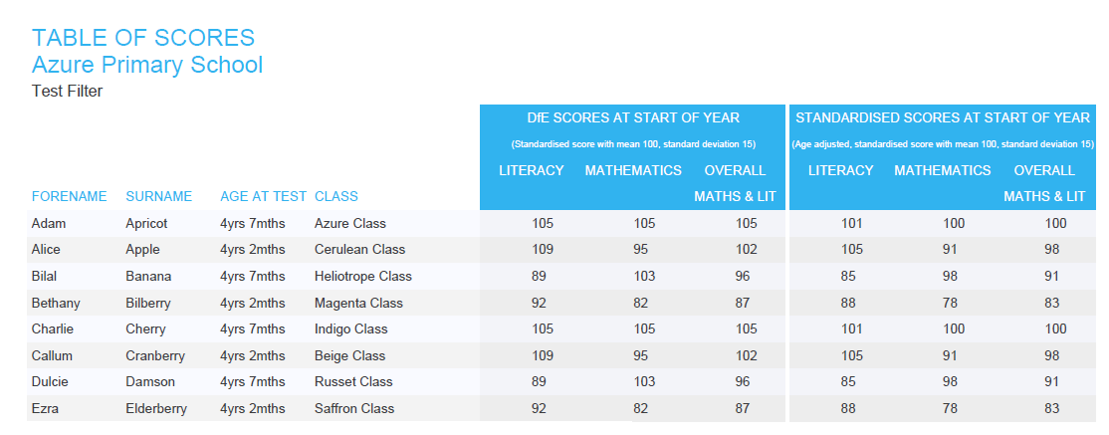
BASE reports

Slide 17
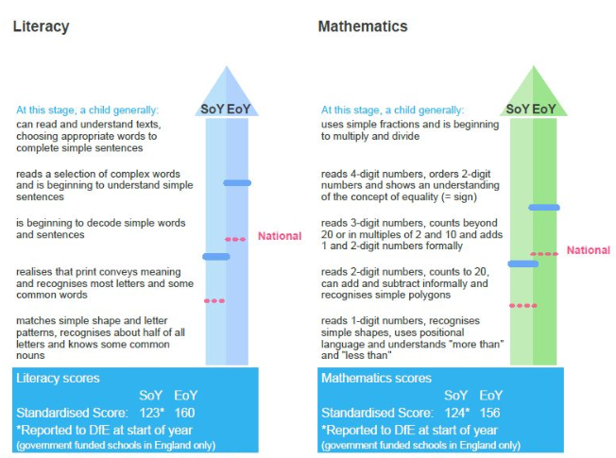
BASE reports

Slide 18
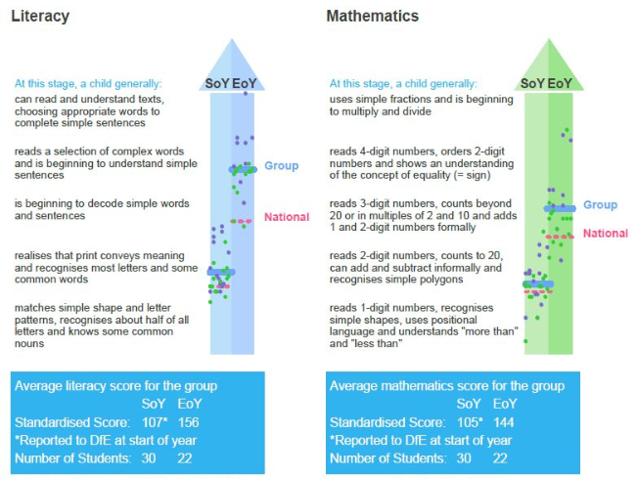
BASE reports

Slide 19
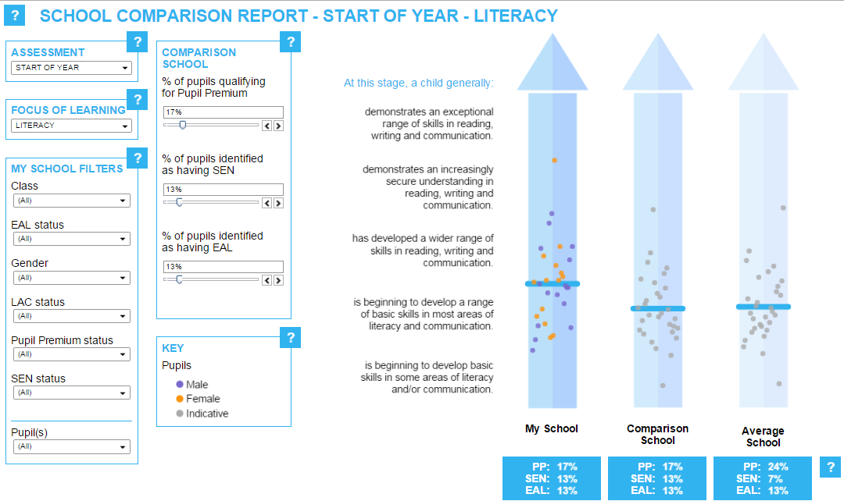
BASE reports

Slide 20
Research question
Is the use of the different levels of score report positively associated with pupil progress during the first year in school?

Slide 21
Study Sample
1034 English primary schools which used BASE Progress or BASE Inspection-ready
37,030 children

Slide 22
Analysis
School information
  State-funded or independent
  Socio-economic status (Income Deprivation Affecting Children Index – IDACI)
  Choice of BASE package
Pupil information
  Start of year literacy and mathematics standardised scores
  End of year literacy and mathematics standardised scores
  Sex of pupil

Slide 23
Multi-level models
Outcome:
Pupil Literacy End of Year Standardised Score
Controls:
Pupil Literacy Start of Year Standardised Score
Pupil Sex
School BASE Package
School State or Independent
School IDACI
Outcome:
Pupil Maths End of Year Standardised Score
Controls:
Pupil Maths Start of Year Standardised Score
Pupil Sex
School BASE Package
School State or Independent
School IDACI

Slide 24
Results: Literacy
All controls were statistically significant
Controls | Model 1 | Model 2 | Model 3 | Model 4
Start of Year Literacy |  |  |  | 
BASE Package |  |  |  | 
IDACI |  |  |  | 
State or Independent |  |  |  | 
Sex |  |  |  | 
Effect Size: BASE Inspection Ready Package | 0.12 | 0.18 | 0.13 | 0.13

Slide 25
Results: Maths
All controls were statistically significant except for IDACI
Controls | Model 1 | Model 2 | Model 3 | Model 4
Start of Year Literacy |  |  |  | 
BASE Package |  |  |  | 
IDACI |  |  |  | 
State or Independent |  |  |  | 
Sex |  |  |  | 
Effect Size: BASE Inspection Ready Package | 0.14 | 0.17 | 0.14 | 0.15

Slide 26
Results
We found a significant association between the type of assessment data provided to teachers and children’s outcomes at the end of the school year
Cultural factors
Levels of engagement
Assessment and data literacy

Slide 27
What next
EEF study
Randomised controlled trial

Slide 28
And finally …

Slide 29
Thank you
Kate.bailey@cem.org

