Slide 1

Translating evidence into improvement:
Why is it so hard?
@ProfCoe
Robert Coe, Durham University
SCHOOLS NorthEast Evidence-based Excellence Event, 9 Feb 2018

Slide 2
Key points
Knowledge of research is important, and good summaries help
Effective implementation depends on teacher skills; improvements depend on teacher learning
Effective implementation depends on good, local, real-time evaluation

Slide 3
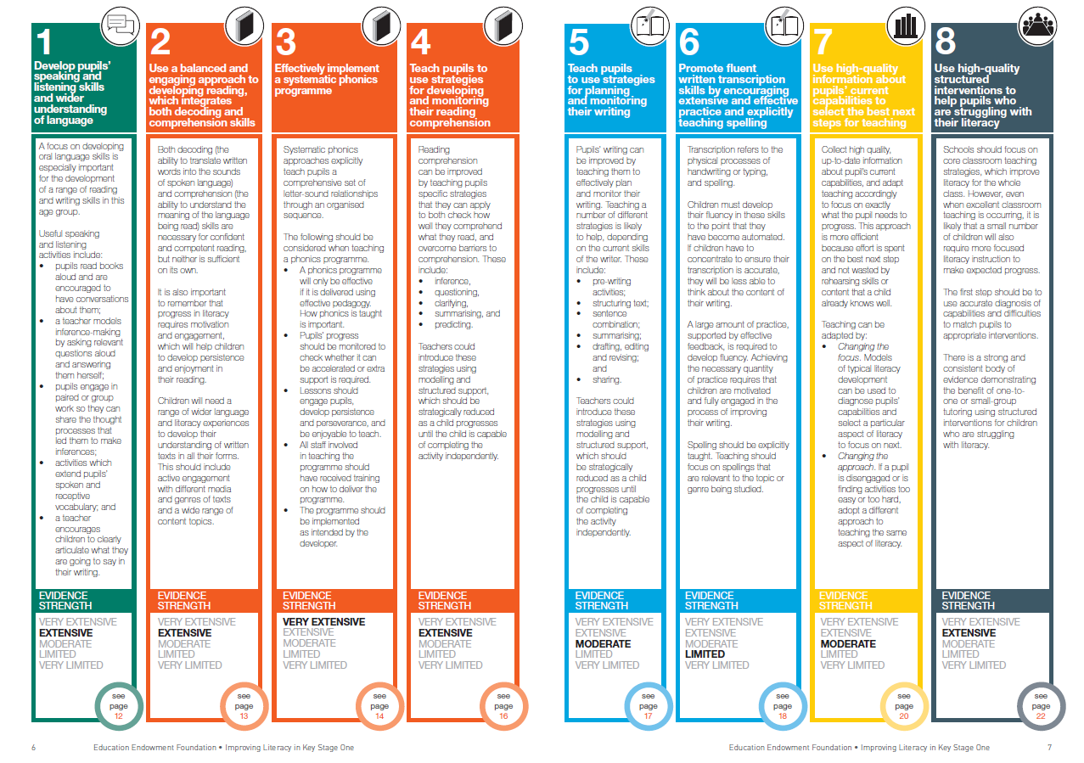
KS1 Literacy Guidance
Develop pupils’ speaking and listening skills and wider understanding of language
Use a balanced and engaging approach to developing reading, which integrates both decoding and comprehension skills
Effectively implement a systematic phonics programme
Teach pupils to use strategies for
developing and monitoring their reading comprehension
Teach pupils to use strategies for
planning and monitoring their writing
Promote fluent written transcription
skills by encouraging extensive and effective practice and explicitly teaching spelling
Use high-quality information about pupils’ current capabilities to select the best next steps for teaching
Use high-quality structured interventions to help pupils who are struggling with their literacy

Slide 4
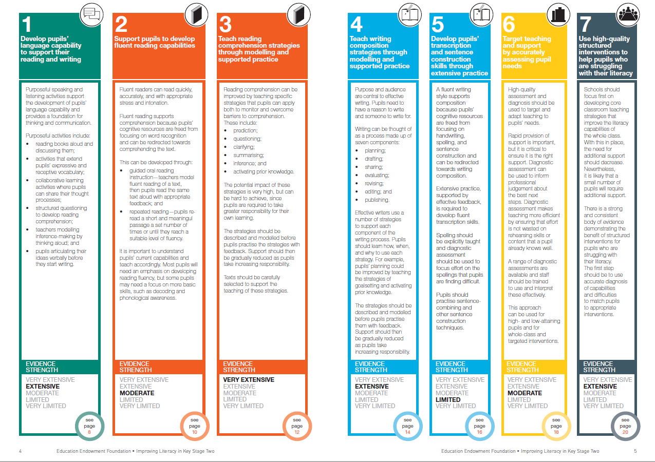
KS2 Literacy Guidance
Develop pupils’ language capability to support their reading and writing
Support pupils to develop fluent reading capabilities
Teach reading comprehension strategies through modelling and supported practice
Teach writing composition strategies through modelling and supported practice
Develop pupils’ transcription and sentence construction skills through extensive practice
Target teaching and support by accurately assessing pupil needs
Use high-quality structured interventions to help pupils who are struggling with their literacy

Slide 5
Will this improve literacy skills?
(almost certainly not)
But …
These reports are excellent: authoritative, evidence-based, concise, user-friendly
Reading, thinking, discussing the research behind the guidance is valuable
This kind of knowledge informs key decisions
These things are hard
If you know how to do these things effectively, then you are probably already doing them
If you are not doing them well already, reading this guidance is not enough to get you there

Slide 6
Takeaway #1
For an activity as complex, constrained and already well optimised as teaching,
there are no simple solutions.
Improvements are likely to be modest
and hard-won.

Slide 7


Expertise requires many hours/years of ‘deliberate practice’
Challenge
Specific goals
Focus on sub-tasks
Feedback
Mental representations
Notes:
Ericsson, K. A. & Pool, R. (2016). Peak: Secrets from the New Science of Expertise. Boston, MA: Houghton Mifflin Harcourt
Deans for Impact (2016). Practice with Purpose: The Emerging Science of Teacher Expertise. Austin, TX: Deans for Impact.
https://deansforimpact.org/resources/practice-with-purpose/

Slide 8
In your CPD have you …
http://tdtrust.org/cpdtest/
Yes No
Tried to learn to do something that is relevant and supported by research evidence?
Focused on (and evaluated success against) students’ learning outcomes?
Engaged in activity that
  Surfaced, challenged and developed your thinking about learning and teaching
  Modelled/demonstrated new approaches
  Allowed experimentation to adapt/apply approaches to your classroom
  Included observation and feedback?
  Took place at least fortnightly over two terms?
Drawn on explicit support from
  External experts
  Peer networks
  Coaches / mentors
  School/college leaders
Notes:
The CPD Test: http://tdtrust.org/cpdtest/
Cordingley, P., Higgins, S., Greany, T., Buckler, N., Coles-Jordan, D., Crisp, B., Saunders, L., Coe, R. (2015) Developing Great Teaching: Lessons from the international reviews into effective professional development. Teacher Development Trust. http://tdtrust.org/about/dgt/
Timperley, H., Wilson, A., Barrar, H. & Fung, I. (2007) Teacher professional learning and development: Best evidence synthesis iteration. Wellington, New Zealand: Ministry of Education. http://www.educationcounts.govt.nz/publications/series/2515/15341

Slide 9


Teachers’ professional learning
Takes you from where you are at
Is clear what success looks like
Creates challenging expectations
Assesses and feeds back on the gap
Requires exposition and guidance from an expert
Requires a coaching & mentoring role
Benefits from peer support
Requires trust: ‘OK to fail’
Notes:
https://www.gov.uk/government/publications/standard-for-teachers-professional-development
Cordingley, P., Higgins, S., Greany, T., Buckler, N., Coles-Jordan, D., Crisp, B., Saunders, L., Coe, R. (2015) Developing Great Teaching: Lessons from the international reviews into effective professional development. Teacher Development Trust. http://tdtrust.org/about/dgt/
The CPD Test: http://tdtrust.org/cpdtest/

Slide 10
How can teachers learn to be better teachers?
You’re a teacher.
You know how to help
people learn hard stuff.
Do that.

Slide 11
Takeaway #2
Significant improvements depend on significant teacher learning

Slide 12
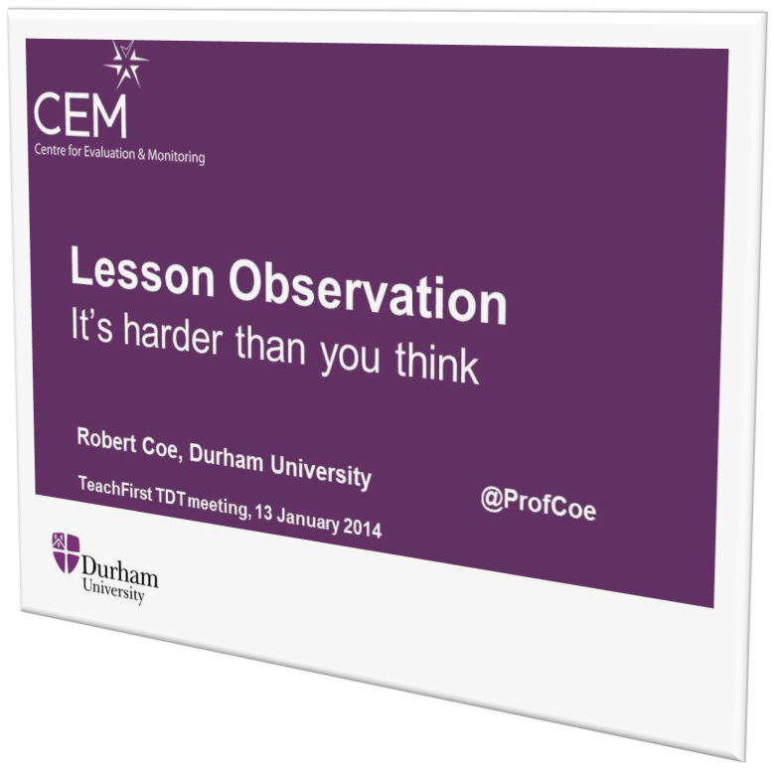
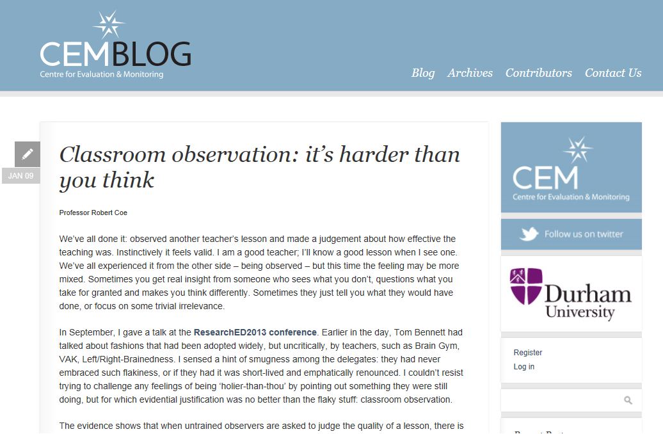
Do we know a good lesson when we see one?
Notes:
http://www.cem.org/blog/414/

Slide 13
Do We Know a Successful Teacher When We See One?
Filmed lessons (or short clips) of effective (value-added) and ineffective teachers shown to
  School Principals and Vice-Principals
  Teachers
  Public
Some agreement among raters, but unable to identify effective teaching
No difference between education experts and others
4 hrs training in RATE achieved ¾ accuracy (better than MET study)
Strong et al 2011; Gargani & Strong, 2014
Notes:
Strong, M., Gargani, J., & Hacifazlioglu, O. (2011). Do we know a successful teacher when we see one? Experiments in the identification of effective teachers. Journal of Teacher Education, 62(4), 367–382. [Abstract at: http://jte.sagepub.com/content/62/4/367.abstract ]
Gargani, J., & Strong, M. (2014). Can we identify a successful teacher better, faster, and cheaper? Evidence for innovating teacher observation systems. Journal of Teacher Education, 65(5), 389-401.

Slide 14
Obvious – but not true
Why do we believe we can spot good teaching?
We absolutely know what we like
  Strong emotional response to particular behaviours/styles is hard to over-rule
We focus on observable proxies for learning
  Learning is invisible
Preferences for particular pedagogies are widely shared, but evidence/understanding of their effectiveness is limited
We assume that if you can do it you can spot it
We don’t believe observation can miss so much

Slide 15
Takeaway #3
Evaluating the quality of teaching is much harder than you think
(even if you think it is really hard)

Slide 16
Key points
Knowledge of research is important, and good summaries help
Effective implementation depends on teacher skills; improvements depend on teacher learning
Effective implementation depends on good, local, real-time evaluation

