Slide 1

A Vision for Enhanced Professionalism
@ProfCoe
Robert Coe
Chartered College of Teaching, 16 Feb 2017

Slide 2
Enhanced Professionalism
Professional evidence
Robust, integrated, understood
Professional development
Every teacher better every year
Professional values
Trust, Confidence, Social justice

Slide 3
Professional evidence
More than just ‘what works’

Slide 4
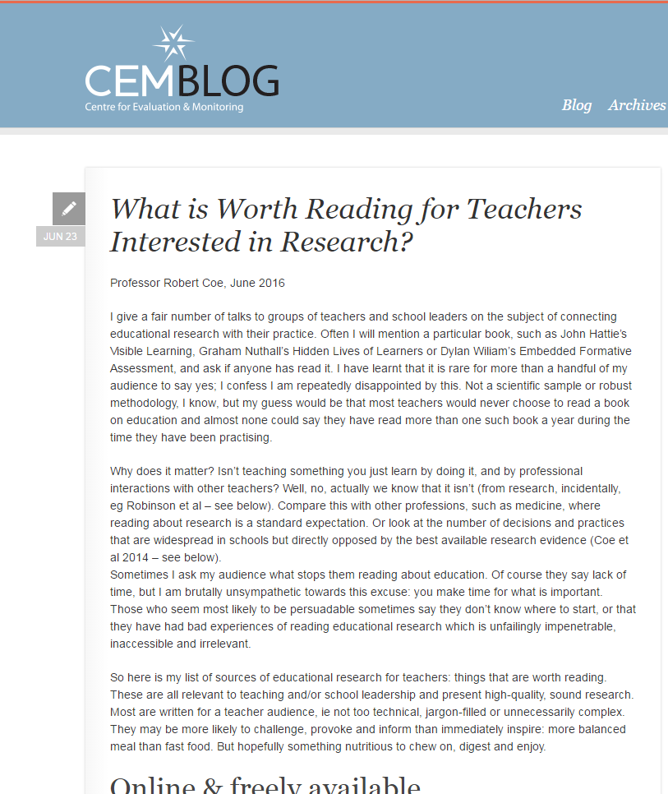
Professional reading http://cem.org/blog/what-is-worth-reading-for-teachers-interested-in-research
Reports (online & free)
Effective pedagogy (6)
Impact of interventions (3)
How learning happens (8)
Teachers’ PD (2)
School improvement and leadership (3)
Books (8)
Blogs (10)

Slide 5

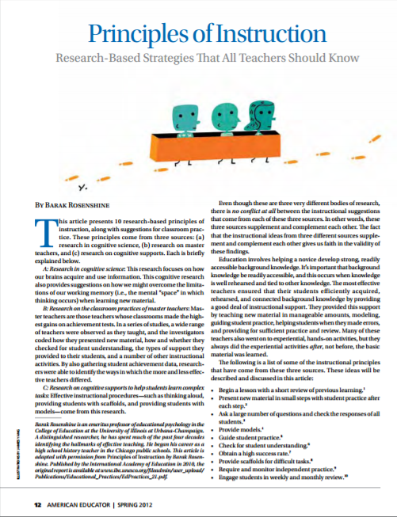


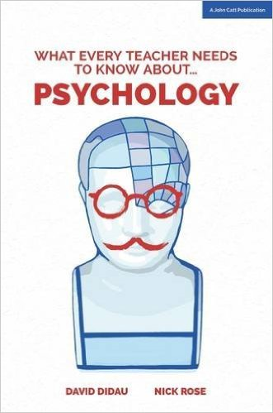
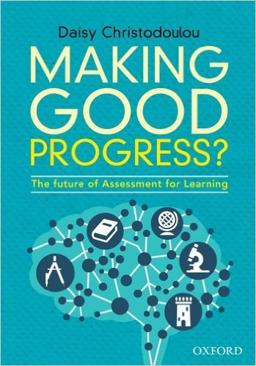
Starter pack: 50 pages
And two new books:
Notes:
Coe, R., Aloisi, C., Higgins, S. and Elliot Major, L. (2014) ‘What makes great teaching? Review of the underpinning research’. Sutton Trust, October 2014 http://www.suttontrust.com/researcharchive/great-teaching/
Rosenshine, B. (2012) Principles of Instruction: Research based principles that all teachers should know. American Educator, Spring 2012. http://www.aft.org/pdfs/americaneducator/spring2012/Rosenshine.pdf
Deans for Impact (2015). The Science of Learning. Austin, TX: Deans for Impact. http://deansforimpact.org/pdfs/The_Science_of_Learning.pdf
Cordingley, P., Higgins, S., Greany, T., Buckler, N., Coles-Jordan, D., Crisp, B., Saunders, L., Coe, R. (2015) Developing Great Teaching: Lessons from the international reviews into effective professional development. Teacher Development Trust. http://tdtrust.org/about/dgt/

Slide 6
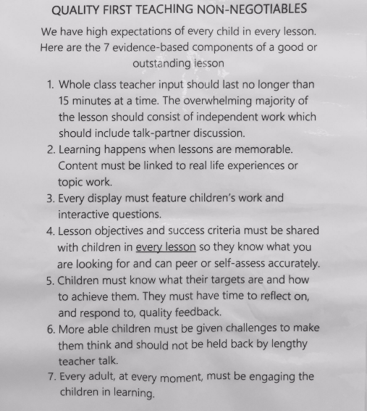
Show me the evidence?
Tweet from
@Mister_Shiney
4:36 PM - 11 Feb 2017
& comment from
@MichaelT1979
@DavidDidau
@InformedEdu
@DylanWiliam
etc
Notes:
https://twitter.com/Mister_Shiney/status/830440390444580864

Slide 7
What is ‘Evidence-Based Practice’?
Evidence based medicine is the conscientious, explicit, and judicious use of current best evidence in making decisions about the care of individual patients. The practice of evidence based medicine means integrating individual clinical expertise with the best available external clinical evidence from systematic research.
By individual clinical expertise we mean the proficiency and judgment that individual clinicians acquire through clinical experience and clinical practice. Increased expertise is reflected in many ways, but especially in more effective and efficient diagnosis and in the more thoughtful identification and compassionate use of individual patients' predicaments, rights, and preferences in making clinical decisions about their care. By best available external clinical evidence we mean clinically relevant research, often from the basic sciences of medicine, but especially from patient centred clinical research into the accuracy and precision of diagnostic tests (including the clinical examination), the power of prognostic markers, and the efficacy and safety of therapeutic, rehabilitative, and preventive regimens.
Sackett et al., 1996
Notes:
David L Sackett, William M C Rosenberg, J A Muir Gray, R Brian Haynes, W Scott Richardson
Evidence based medicine: what it is and what it isn't
BMJ 1996; 312 doi: http://dx.doi.org/10.1136/bmj.312.7023.71 (Published 13 January 1996)

Slide 8
Impact vs cost
www.educationendowmentfoundation.org.uk/toolkit
Most promising for raising attainment
8
Feedback
May be worth it
Meta-cognitive
Mastery
Homework (Secondary)
Peer tutoring
1-1 tuition
Early Years
Effect Size (months gain)
Reading comprn
Collaborative
Behaviour
Phonics
Small gp tuition
Parental involvement
Smaller classes
Social
ICT
Individualised learning
Summer schools
After school
Small effects / high cost
Homework (Primary)
Mentoring
Teaching assistants
0
Performance pay
Aspirations
£0
Ability grouping
£1000
Cost per pupil
Repeating a year

Slide 9
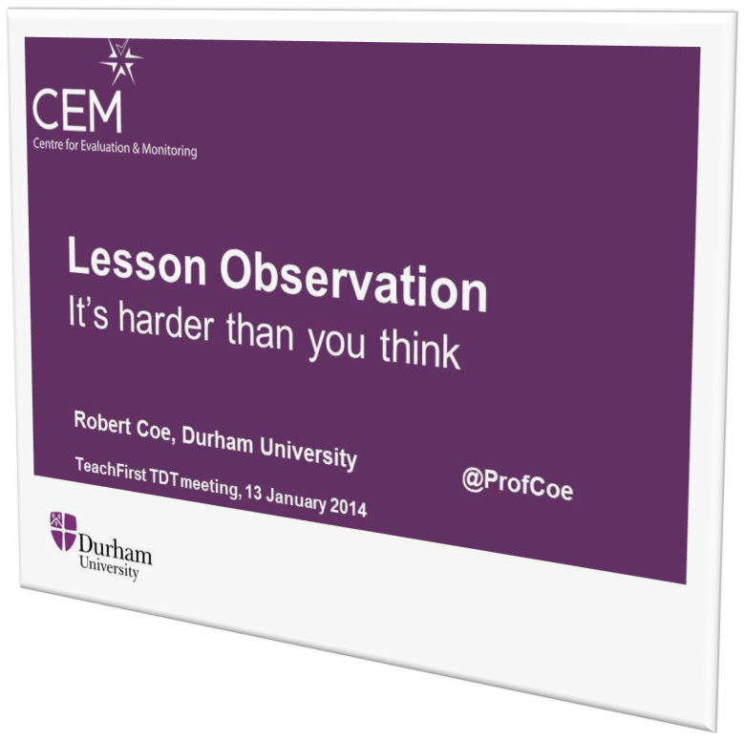
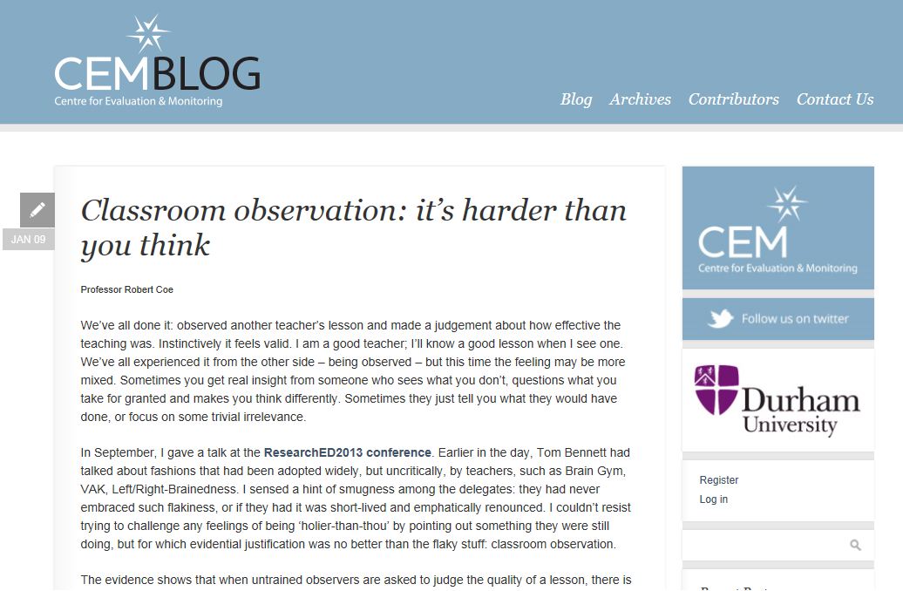
Do we know a good lesson when we see one?
Notes:
http://www.cem.org/blog/414/

Slide 10
The #1 fact about ‘what works’:
It doesn’t always work

Slide 11
Even if you follow the evidence, it may not work, so
Monitor
Routine, on-going, real-time collection of data
Analysis and evaluation to see what seems to be working
Feedback into processes
Evaluate
For interventions, changes, investments
Is the impact worth the cost?

Slide 12
Professional development
Every teacher better every year

Slide 13

www.gov.uk/government/publications/standard-for-teachers-professional-development
Notes:
https://www.gov.uk/government/publications/standard-for-teachers-professional-development

Slide 14
What do we know about teachers’ professional learning?
Three types of requirement
Mostly, teachers learn the same way as other people
There are some important things that are specific to learning to teach
The learning environment also matters: school culture and leadership

Slide 15
All good learning & teaching …
Takes you from where you are at
Is clear what success looks like
Creates challenging expectations
Assesses and feeds back on the gap
Requires exposition and guidance from an expert
Requires a coaching & mentoring role
Benefits from peer support
Requires trust: ‘OK to fail’

Slide 16
Principles for learning to change pedagogical practice
Learning aims (for teachers) must be strongly linked to learning gains (for pupils)
Learning aims must be evidence based
Learning aims must be appropriate to school/pupil context
Changing habits that are already established is very hard (needs time, support, feedback)
Pedagogy is a blend of theory (wisdom and intuition) and practice (skills and techniques)

Slide 17
Leadership, school culture and professional learning
The value of professional learning and continuous improvement must be clearly signalled (championed and modelled)
Time and funding must be made available
A trust culture (‘willingness to be vulnerable’ = please observe my worst lesson) is vital
Challenge implies need for improvement
Requires coherence with a wider strategic planning process for prioritisation and integration
Notes:
Tschannen-Moran, M., & Hoy, W. K. (2000). A multidisciplinary analysis of the nature,
meaning, and measurement of trust. Review of Educational Research, 70(4), 547-593.

Slide 18

How to be better next year than this
Focus on improving one thing (evidence-based)
Eg ‘Begin a lesson with a short review of previous learning’
Assess your baseline on it
Eg ask someone who is really good at this to evaluate; video
Ensure you have the right support
Expertise, leadership, coaching, peer support
Work at it (‘Deliberate Practice’) for a sustained period
See ‘Peak’ & ‘Practice with Purpose’
Reassess to inform & track progress
& revisit long after you have moved on to something else
Notes:
Deans for Impact (2016). Practice with Purpose: The Emerging Science of Teacher Expertise. Austin, TX: Deans for Impact
Ericsson, K. A. & Pool, R. (2016). Peak. Boston, MA: Houghton Mifflin Harcourt.

Slide 19
Professional values
Otherwise, why be a teacher?

Slide 20
What is trust?
Inter-dependence, risk of harm
“willingness to be vulnerable to another party based on the confidence that the latter party is (a) benevolent, (b) reliable, (c) competent, (d) honest, and (e) open”
(Tschannen-Moran & Hoy, 2000)
Good intentions, would not exploit
Lack of anxiety
Predictability, consistency of behaviour
Skills, abilities, power
Willing to share (personal) information
character, integrity, authenticity
Notes:
Tschannen-Moran, M., & Hoy, W. K. (2000). A multidisciplinary analysis of the nature,
meaning, and measurement of trust. Review of Educational Research, 70(4), 547-593.

Slide 21
Trust in school
Schools “with weak trust reports … had virtually no chance of showing improvement” (Bryk & Schneider, 2002, p. 111).
‘Academic Optimism’ (Hoy et al, 2006)
Academic Emphasis: press for high academic achievement
Collective Efficacy: teachers’ belief in capacity to have positive effects on students
Trust: teachers’ trust in parents and students
If what you are doing isn’t good, do you want to
Cover it up, ignore, hide, minimise its importance
Expose it, share, examine, maximise the learning opportunity
Notes:
Bryk, A., & Schneider, B. (2002). Trust in schools. New York: Russell Sage.
Hoy, W. K., Tarter, C. J., & Hoy, A. W. (2006). Academic optimism of schools: A force for student achievement. American educational research journal, 43(3), 425-446.

Slide 22
Confident professionalism
Strong moral purpose
Specialist expertise
Openness to criticism and challenge
Regard for good evidence
Robust evaluation (of ourselves)
Every teacher better every year
Seek inclusive solutions, not fight battles
Collective voice

Slide 23
“After 30 years of doing such work, I have concluded that classroom teaching…is perhaps the most complex, most challenging, and most demanding, subtle, nuanced, and frightening activity that our species has ever invented…The only time a physician could possibly encounter a situation of comparable complexity would be in the emergency room of a hospital during or after a natural disaster.”
Lee Shulman, The Wisdom of Practice

